Slide 1
Stats 231 Project 1
Daniel O'Connor
Fall 2009

Slide 2
Step 1

Slide 3
Brief description:
In step 1 I performed PCA on 150 training faces, and used the resulting eigenfaces to reconstruct 28 testing faces.
To perform PCA, I first constructed a matrix T with 150 rows. Each row is a mean-subtracted image (written
as one long vector), so T has 256^2 columns. The
eigenfaces PCA computes are the eigenvectors of
transpose(T) * T. This matrix is too large to work with
directly, but there is a trick: compute the eigenvectors
of T * transpose(T). If v is an eigenvector of
T * transpose(T), then transpose(T) * v is an eigenvector of transpose(T) * T.
The difference between a testing image and the mean training image may be approximated by the sum of its projections onto the first k eigenfaces.

Slide 4
On the following slide you can see the first 20 eigenfaces. Start at top left and look row by row to see them in order.
No landmarks are being used.

Slide 5
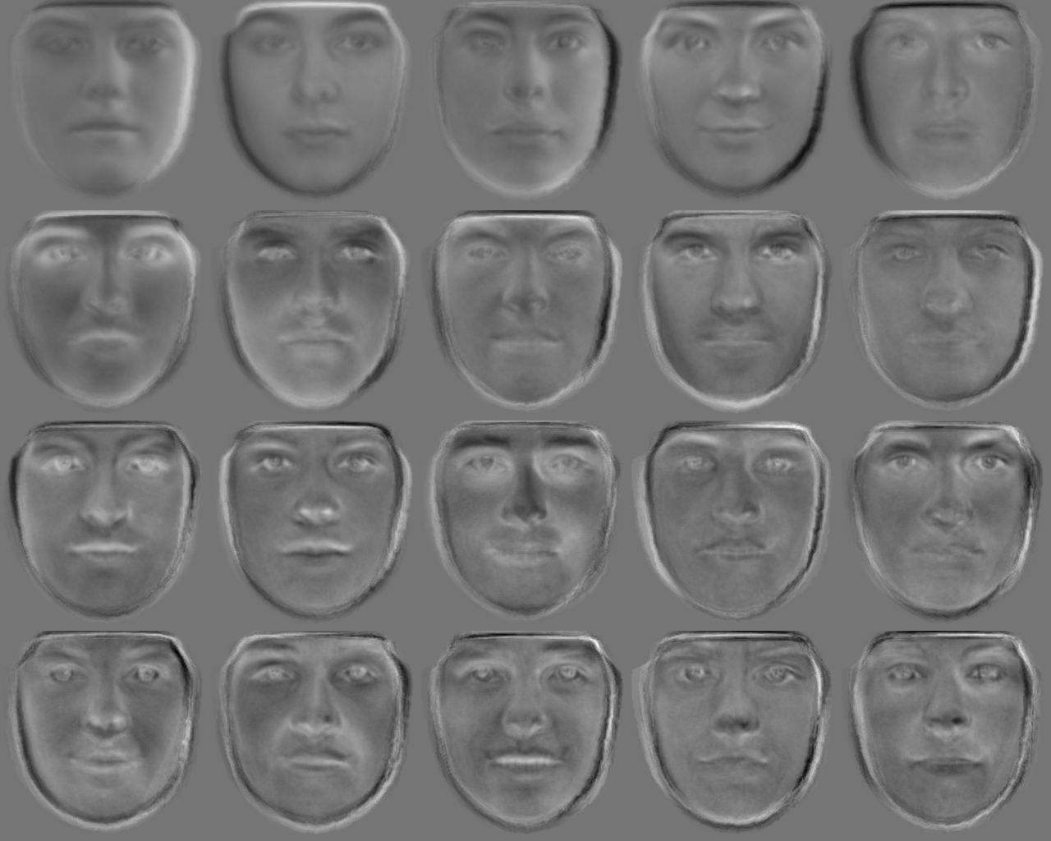

Slide 6
Next you see reconstructions of the 28 training faces using 20 eigenfaces. No landmarks are being used.

Slide 7
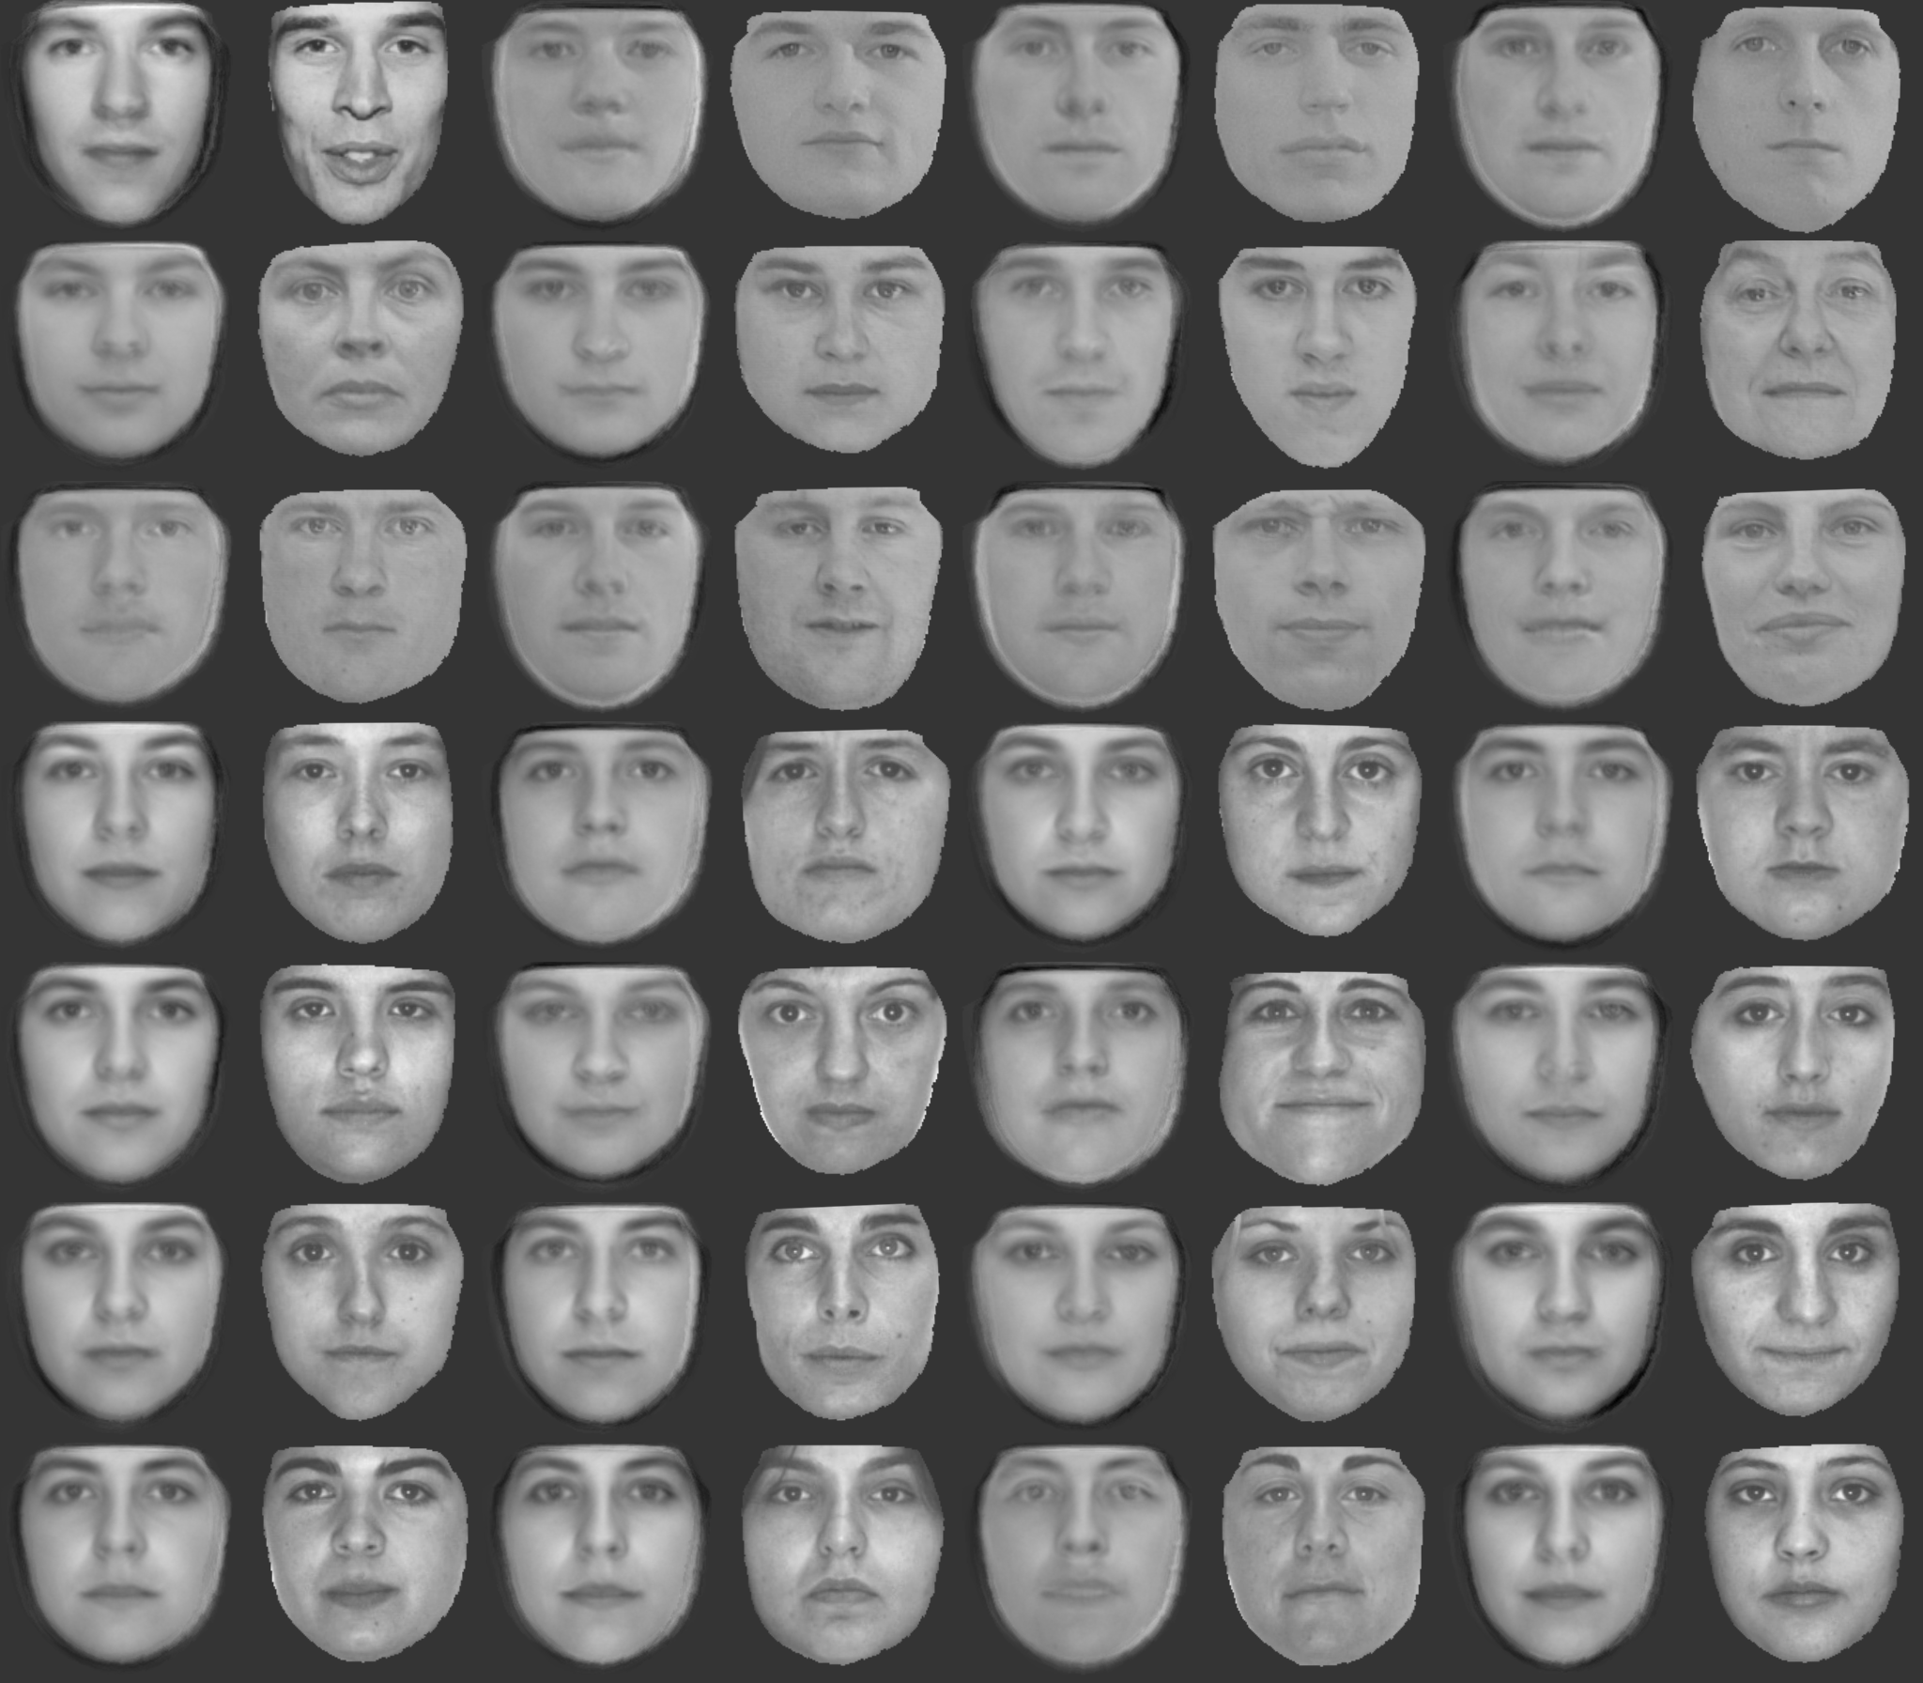

Slide 8
The following slide shows error per pixel for the successive approximations to image 150. Horizontal axis shows number of eigenfaces used in the approximation. Error was computed as follows:
diff = face - approxFace;
errorsL2(eigFaceIdx) = ... norm(diff(:))/sqrt(numRows*numCols);

Slide 9
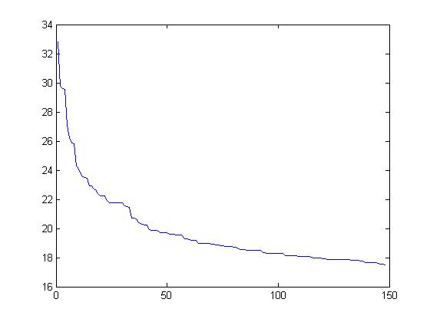
Error per pixel vs. number of eigenfaces used in approximation. No landmarks used.

Slide 10
Step 2

Slide 11
Brief description:
Approximation by eigenfaces may be improved if the face data
come with landmarks, so that the face images can be registered
before PCA is performed. However, the landmark data itself
may be cumbersome: 87*2 extra numbers you have to store for
each image. We can deal with this by using PCA on the vectors of landmarks (a.k.a. the "warpings") that accompany each training image. The difference between a new warping and the mean warping (from training data) may then be approximated by the sum of its projections onto the first k eigen-warpings (computed from training data). This may allow a new warping to be represented fairly well by, say, 20 numbers.
How do you display an eigen-warping? An eigen-warping can be thought of as having two components for each mean landmark position, expressing a direction and a magnitude for change away from the mean landmark position. An eigen-warping can be displayed by drawing these vectors at their corresponding landmark positions.

Slide 12
The next slides show the first five eigenwarpings.

Slide 13
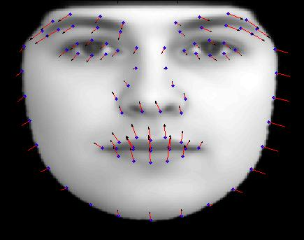

Slide 14
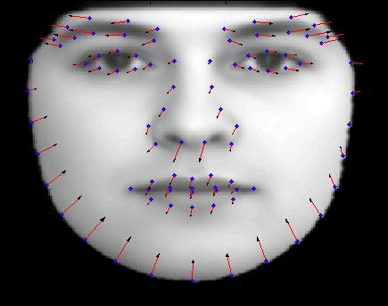

Slide 15
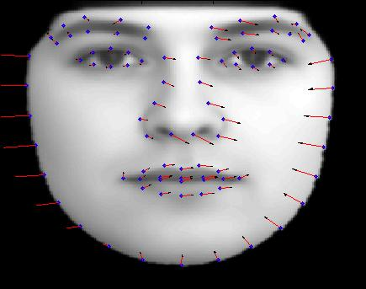

Slide 16
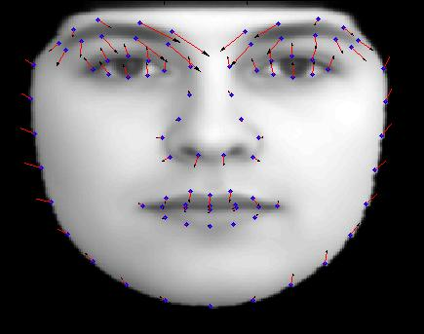

Slide 17
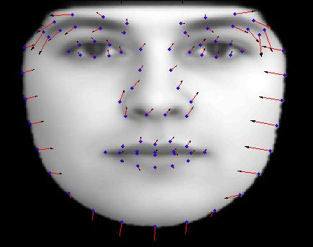

Slide 18
The next slide shows landmark reconstructions for faces 150 - 153, using 5 eigenwarpings.
True landmarks are shown in blue.
Reconstructed landmarks are shown in red.

Slide 19
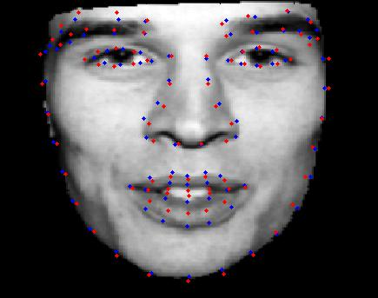
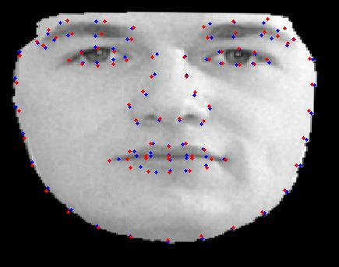
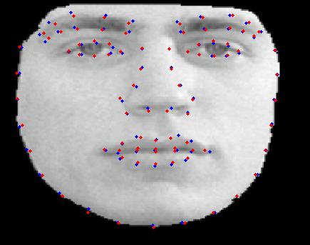
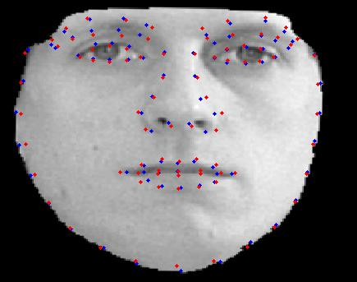

Slide 20
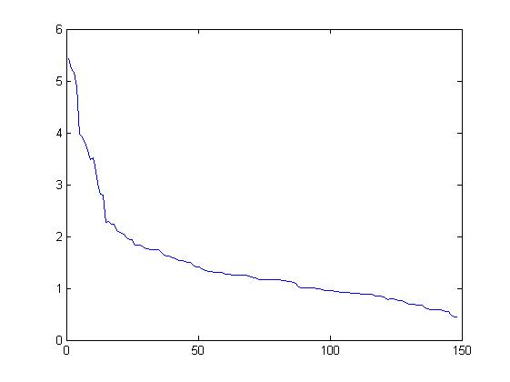
Landmark reconstruction error (pixels per landmark) as a function of the number of eigenwarpings used in reconstruction. This is for face 150.

Slide 21
Step 3

Slide 22
Brief description:
Given a testing image, its warping is approximated using eigen-warpings. The testing image is then warped using the approximate eigen-warping. The warped image is then approximated using eigenfaces that were computed from warped (registered to the mean) training data. This approximation to the warped image is then unwarped, again using the approximate warping, to obtain an approximation to the original unwarped testing image.
In this way, an image of a face may be represented by just 40 numbers: 20 of them are coefficients for the first 20 eigenfaces, and 20 of them are coefficients for the first 20 eigen-warpings.

Slide 23
The next slide shows reconstructions of the test faces using 20 eigenfaces and 20 eigenwarpings.

Slide 24
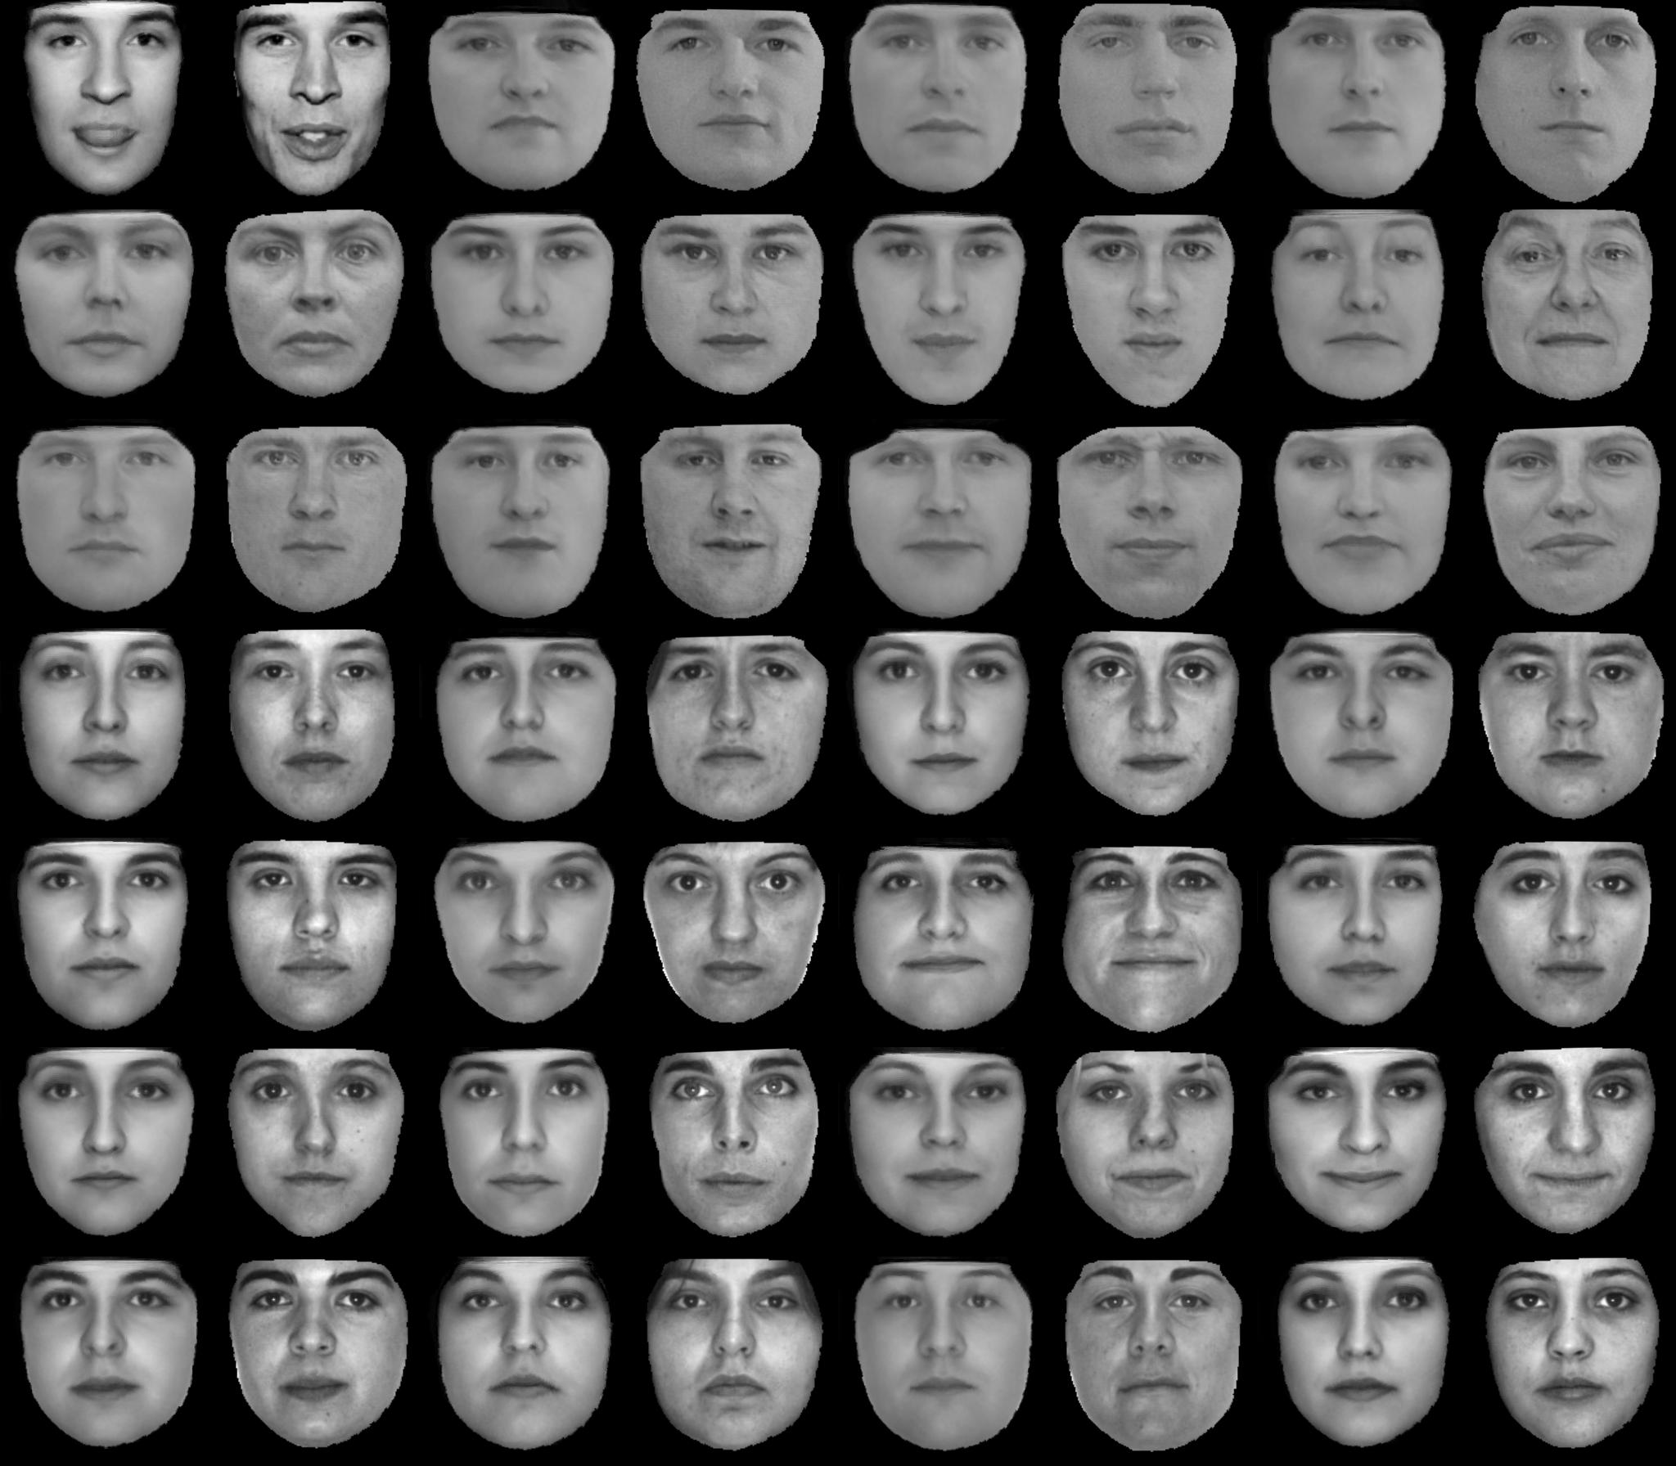

Slide 25
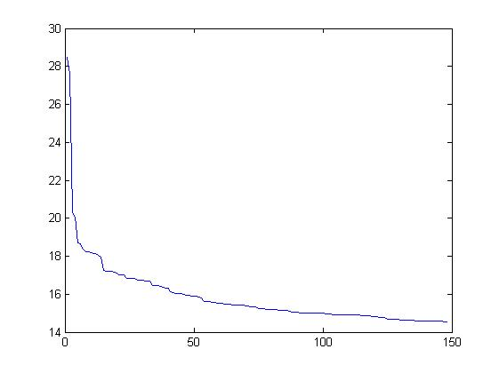
Error per pixel as a function of the number of eigenfaces used in approximation for face 150. Error is computed on warped images.

Slide 26
Step 4

Slide 27
Brief description:
By randomly choosing coefficients for the eigen-faces and eigen-warpings, we can synthesize new faces of people who don't actually exist. The coefficient of an eigenvector with eigenvalue lambda should be chosen from a Gaussian distribution with mean zero and standard deviation sqrt(lambda).

Slide 28
The next slide shows 20 synthesized faces.

Slide 29
